Slide 1
Basic Electrical and Electronics Engineering
LECTURE 3.6
Dr. Sonam Shrivastava/ Assistant Professor (Sr.) /SELECT

Slide 2
BEEE102L
Basic Electrical and Electronics Engineering
DC Circuits
AC Circuits
Magnetic Circuits
Electrical Machines
Semiconductor Devices and Applications
Digital Systems

Slide 3
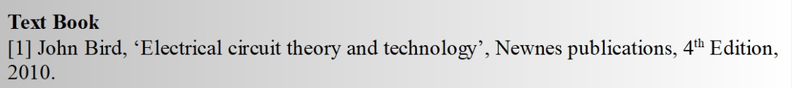
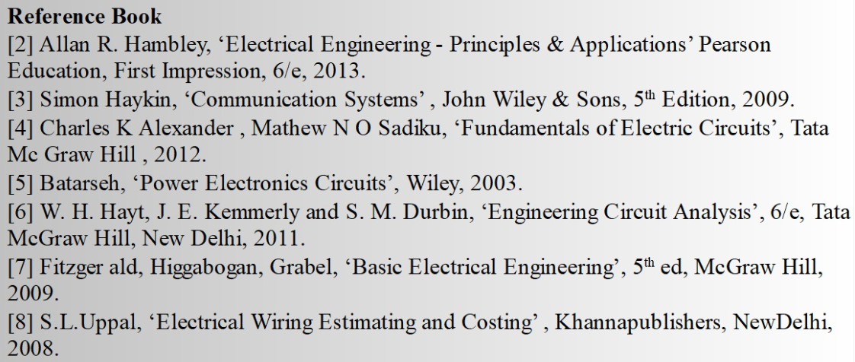
Books

Slide 4
Module 3. Magnetic Circuits
Electromagnetic Induction: Self And Mutual
Magnetically Coupled Circuits
Series and Parallel Magnetic Circuits
Dot Convention

Slide 5
Magnetic Coupling
Magnetic coupling occurs, when there is no physical connection between two coils (or inductors). This coupling can be of either aiding type or opposing type. It is based on whether the current enters at the dotted terminal or leaves from the dotted terminal.
Coupling of Aiding type
Coupling of Opposing type

Slide 6
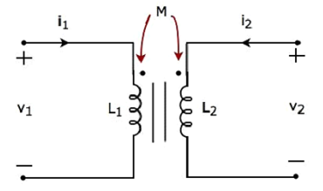
Magnetic Coupling of Aiding type
Consider the following electrical equivalent circuit of transformer. It is having two coils and these are called as primary and secondary coils..
The currents flowing through primary and secondary coils are i1 and i2 respectively. In this case, these currents enter at the dotted terminal of respective coil. Hence, the induced voltage in each coil will be having positive polarity at the dotted terminal due to the current flowing in another coil.

Slide 7
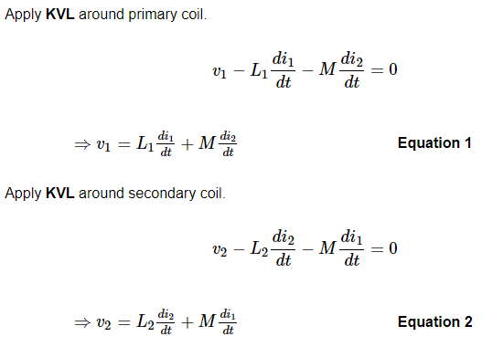
In Equation 1 and Equation 2, the self-induced voltage and mutually induced voltage have the same polarity. Hence, the above transformer circuit is an example of magnetic coupling, which is of aiding type.

Slide 8
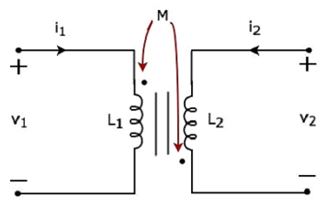
Magnetic Coupling of opposing type
Consider the following electrical equivalent circuit of transformer. It is having two coils and these are called as primary and secondary coils..
The currents flowing through primary and secondary coils are i1 and i2 respectively. In this case, the current, i1 enters at the dotted terminal of primary coil. Hence, it induces a voltage in secondary coil. So, positive polarity of the induced voltage is present at the dotted terminal of this secondary coil.
In the above circuit, the current, i2 leaves from the dotted terminal of secondary coil. Hence, it induces a voltage in primary coil. So, negative polarity of the induced voltage is present at the dotted terminal of this primary coil.

Slide 9
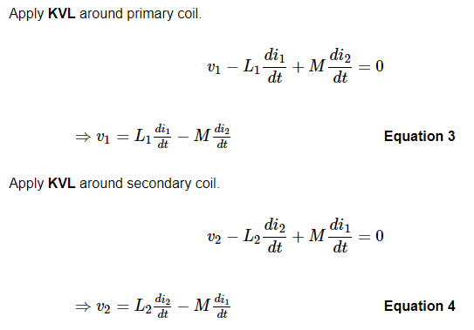
In Equation 3 and Equation 4, self-induced voltage and mutually induced voltage are having opposite polarity. Hence, the above transformer circuit is an example of magnetic coupling, which is of opposing type.

Slide 10
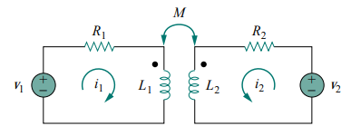


Time domain analysis of magnetically coupled circuit
Applying KVL to coil 1 gives
Applying KVL to coil 2 gives

Slide 11
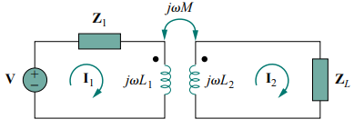


Frequency domain analysis of magnetically coupled circuit
Applying KVL to coil 1 gives
Applying KVL to coil 2 gives

Slide 12
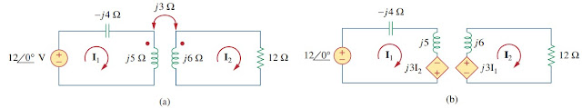
Question 1: Calculate the phasor currents I1 and I2 in the circuit of Figure.

Slide 13
Question 1: Calculate the phasor currents I1 and I2 in the circuit of Figure.

Slide 15
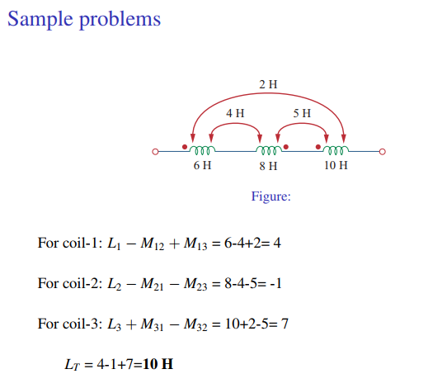

Slide 17
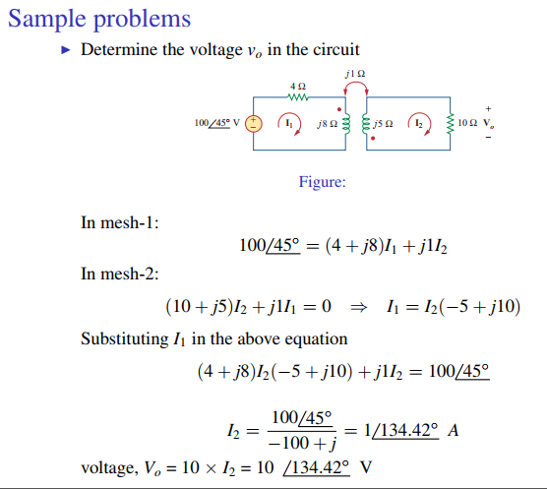

Slide 19
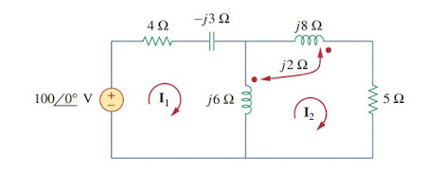
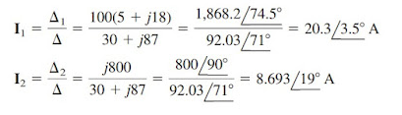

Question 2: Calculate the phasor currents I1 and I2 in the circuit of Figure.
2j(${I_{1}−I}_{2}$)

Slide 20
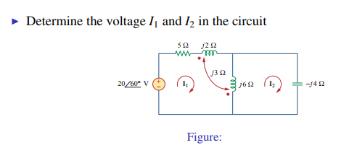

Slide 21
